Slide 1
SESSION 1
Explore
Unit Rates for Ratios with Fractions
Learning Targets
Find unit rates for ratios with fractions.
Solve problems involving ratios with fractions.
LESSON 2 • Find Unit Rates Involving Ratios of Fractions
Notes:
Purpose
Explore the idea that fractions can be used to express unit rates.
Understand how unit rates expressed as fractions can be used to solve problems.
Error Alert In this lesson, watch for students who:
do not understand that complex fractions represent division problems.
make computation errors when dividing fractions.
misinterpret or incorrectly set up unit rates.
misapply unit rate when finding unknown quantities.
do not recognize that calculating unit rates with fractions has the same process as calculating unit rates with whole numbers.

Slide 2
Start
Which One Doesn’t Belong?
1 ticket for $1.80
$9 buys 5 tickets
A
B
C
D
9 tickets for $15
10 prizes for $18
Notes:
START (Teacher’s Guide page 33)
WHY? Support students’ ability to apply patterns, recognize ratios in context, and use proportional reasoning.
Consider providing a sentence starter to help students express their thinking:
_______ does not belong because _______.
Possible Solutions
A has the only price that includes cents.
B lists the price first.
C has a different per ticket price.
D describes prizes instead of tickets.

Slide 3
CONNECT TO CULTURE Optional
Weaving has been practiced all over the world for thousands of years. The pattern of the rug shown in the photograph is common among the Diné people of the Southwestern United States.
What is your experience with weaving, knitting, crocheting, or sewing?
Notes:
Connect to Culture (Teacher’s Guide page 31c)
Engage students in sharing what they know about the context before you add the information given here.
Ask students to share their experiences with weaving, knitting, crocheting, or sewing. Weaving has been practiced all over the world for thousands of years. The pattern of the rug shown in the photograph is common among the Diné people of the Southwestern United States. The Diné weave rugs in a traditional style that has changed little over time, although the fibers are now typically wool instead of cotton. Other indigenous peoples craft distinctive woven products, including the Tlingit of the Pacific Northwest and the Lakota of the Great Plains.

Slide 4



Make sense of the problem
Grace’s grandmother weaves a rug that is
yard wide and 2 yards long. Grace wants to weave a rug that uses the same design
but is 1 yard wide.
What do you notice?
What do you wonder?
33
Notes:
Notice and Wonder
Give students some individual think time before asking the group to name things they notice and things they wonder. Conclude by drawing a rectangle the same shape as the rug on the board. Ask: What do you notice about the rug? What do you wonder about the way the shape could change?

Slide 5
Make sense of the problem
Grace’s grandmother weaves a rug that is
yard wide and 2 yards long. Grace wants to weave a rug that uses the same design
but is 1 yard wide. How long will the rug be?
What information is important based on what you need to find?
33

Slide 6
Solve and support your thinking
Grace’s grandmother weaves a rug that is
yard wide and 2 yards long. Grace wants to weave a rug that uses the same design
but is 1 yard wide. How long will the rug be?
Math Toolkit double number lines, fraction bars, fraction tiles, grid paper
33

Slide 7

Share your thinking with a partner
Ask: What did you do first to find the length?
Share: I knew . . . so I . . .
33
Notes:
Common Misconception Listen for students who confuse the width with the length of the rug that Grace wants to weave. These students might calculate the scale factor between the new rug and the old rug as 1 : 2. As students share their strategies, encourage them to draw and label a diagram of each rug on the board. During whole-class discussion, support students in presenting their findings that the width of the rug increases from 1/3 yard for the old rug to 1 yard for the new rug. The ratio of the widths is 1/3: 1, or 1 : 3.
Select and Sequence Student Strategies
Select 2–3 samples that represent the range of student thinking in your classroom. Here is one possible order for class discussion:
diagram that relates the width of the old rug and the new rug
(misconception) strategy that uses the scale factor 1 : 2 based on confusing length and width.
tables or double number lines that compare the widths and lengths of different rugs

Slide 8

Compare class strategies
Grace’s grandmother weaves a rug that is
yard wide and 2 yards long. Grace wants to weave a rug that uses the same design
but is 1 yard wide. How long will the rug be?
33
Notes:
Call on students to share selected strategies. Remind students to project their voices when they speak to the class.
Guide students to Compare and Connect the representations. To engage all students, have them turn and talk with a partner before responding to the questions about how the representations are alike, different, and connected.
ASK How do [student name]’s and [student name]’s strategies use the dimensions of the original rug?
LISTEN FOR They both show a ratio of 1/3 : 2 for width to length and use that information to find the length when the width increases to 1.

Slide 9


Make connections and explain your thinking
Look Back How long is the rug that is 1 yard wide? Explain how you know.
34
Notes:
Look for understanding that adding increments of 1/3 yard to the width and 2 yards to the length produces rectangles that are the same shape as Grace’s rug.

Slide 10





Make connections and explain your thinking
Look Ahead The original rug has a length of 2 yards and a width of yard. You can write the ratio of length to width as 2 : . To find the unit rate, you can start with the complex fraction . Fractions in which the numerator, the denominator, or both are also fractions are called complex fractions.
a. You can simplify a complex fraction by dividing. Since a fraction bar represents division, you can think of as . Then you can divide to simplify. What is the unit rate for the ratio of length to width of the original rug?
34
Notes:
Point out that the ratio of the length to the width is the same for both rugs. Students should recognize that ratios written with fractions can be simplified to use whole numbers only.
Ask a volunteer to rephrase the definition of complex fraction. Support student understanding of complex fractions by comparing them to simple fractions. Include equivalent expressions for 2/(1/3), such as 2 ÷ 1/3.

Slide 11
Make connections and explain your thinking
Look Ahead The original rug has a length of 2 yards and a width of yard. You can write the ratio of length to width as 2 : . To find the unit rate, you can start with the complex fraction . Fractions in which the numerator, the denominator, or both are also fractions are called complex fractions.
b. Rewrite the complex fraction as a division expression using .
c. What is the quotient as a simplified fraction?
34

Slide 12
Make connections and explain your thinking
Look Ahead The original rug has a length of 2 yards and a width of yard. You can write the ratio of length to width as 2 : . To find the unit rate, you can start with the complex fraction . Fractions in which the numerator, the denominator, or both are also fractions are called complex fractions.
d. Suppose a bug travels mile in 12 minutes. Write a complex fraction you could use to find the speed of the bug in miles per minute. What is the bug’s speed in miles per minute?
34

Slide 13


Close: Exit Ticket
Reflect Are and equivalent fractions? Explain.
34
Notes:
Look for understanding of simplifying complex fractions to determine whether they are equivalent.
Common Misconception If students incorrectly simplify complex fractions, such as simplifying 1/(3/4) to 3/4, then encourage students to express the fraction as a division problem. Discuss how to simplify it by multiplying by the reciprocal.

Slide 14
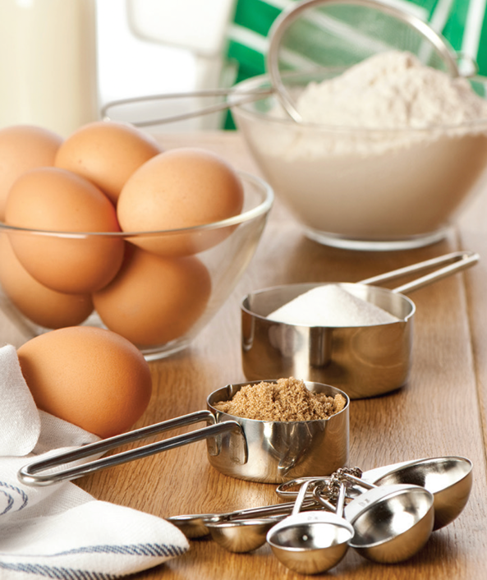
Real-World Connection
Chefs and bakers use ratios to determine the amounts of ingredients in a recipe. When one ingredient changes, the amounts for the other ingredients must change to keep the ratios equivalent.
When might it be useful to use ratios to determine an amount or quantity?
Notes:
Real-World Connection (Teacher’s Guide page 35)
Read the real-world example below. Then ask students to think of other real-world examples when using ratios to determine an amount or quantity might be useful.
Chefs and bakers use ratios to determine the amounts of ingredients in a recipe. When one ingredient changes, the amounts for the other ingredients must change to keep the ratios equivalent. For example, if a recipe calls for 1/2 teaspoon of baking powder for every 2 cups of flour, a new quantity of baking powder must be calculated when 5 cups of flour are used. Ask students for other examples of using ratios to determine an amount or quantity.

Slide 15

Vocabulary
What Is It?
What I Know About It
ratio
Examples
Examples
35
Notes:
Students should understand that a ratio is a comparison describing the relationship between two or more quantities and can be expressed using words or a colon. Student responses might include examples such as the ratio of colors in a mixture of paint or the ratios of ingredients in a recipe. Students should recognize that the quantities in a ratio may have the same units or different units.

Slide 16

Practice
On a bookshelf there are 5 paperback books and 3 hardcover books. Is the ratio of books to hardcover books 5 : 3? Explain.
35

Slide 17


Practice
Muna is making a scale drawing of a gecko.
The gecko is inch wide and 5 inches long.
a. She decides to make her drawing of the gecko 1 inch wide. How long will the drawing be? Show your work.
36
Notes:
Suggest that students use Notice and Wonder, asking themselves these questions:
What do you notice about this problem?
What are you wondering about that mathematics can answer?

Slide 18
Practice
Muna is making a scale drawing of a gecko.
The gecko is inch wide and 5 inches long.
b. Check your answer to problem 3a.
Show your work.
36
Notes:
Suggest that students use Notice and Wonder, asking themselves these questions:
What do you notice about this problem?
What are you wondering about that mathematics can answer?

Slide 19

Take a moment to think on your own.
Notes:
Individual Think Time (10 seconds to 2 minutes)
Provide students a short time to think about a question or problem before discussing with a partner, a small group, or the whole class.
Three Reads
After each read, provide students with think time to read the question and consider their answer.
Connect It
Give students think time before discussing as a class.
Facilitate Whole Class Discussion
After each strategy, allow individual think time for students to process the ideas.
Understand lessons
Model It
Read the problem and allow students plenty of think time to determine their answer.

Slide 20

Turn and talk with your partner about . . .
Notes:
Turn and Talk (30 seconds to 1 minute)
Give students a purpose, prompt, or product so that they know what to talk about and why.

Slide 21

REPEAT
Restate the idea to give everyone a chance to hear it, or hear it again.
Notes:
Four Rs: Repeat
Use one or a combination the Four Rs to support students in processing information and to facilitate classroom discussion.

Slide 22
REPHRASE
Restate the idea in your own words.
Notes:
Four Rs: Rephrase
Use one or a combination the Four Rs to support students in processing information and to facilitate classroom discussion.

Slide 23
REWORD
Restate the idea using academic or mathematical language.
Notes:
Four Rs: Reword
Use one or a combination the Four Rs to support students in processing information and to facilitate classroom discussion.

Slide 24
RECORD
Record ideas using words, numbers or pictures.
Notes:
Four Rs: Record
Record students’ ideas for reference. Use words, numbers, or pictures.

Slide 25

THREE READS
Read 1: What is the problem about?
Read 2: What are you trying to find out?
Read 3: What information is important?

Slide 26

CO-CRAFT QUESTIONS
What is the problem about?
What questions can you ask that
mathematics can answer?

Slide 27

NOTICE AND WONDER
What do you notice?
What do you wonder?

Slide 28

SAY IT ANOTHER WAY
How would you say this problem in your own words?

